Slide 1
ISM 6562
Big Data
Dr. Tim Smith

Slide 2
Agenda
The 8 Database Paradigms
MongoDB
MongoDB Tutorial
This week’s deliverables
Upcoming Midterm

Slide 3
8 database paradigms
Key-Value
Wide Column
Document Oriented
Relational
Graph
Search Engine
Multi-Model
Vector

Slide 4
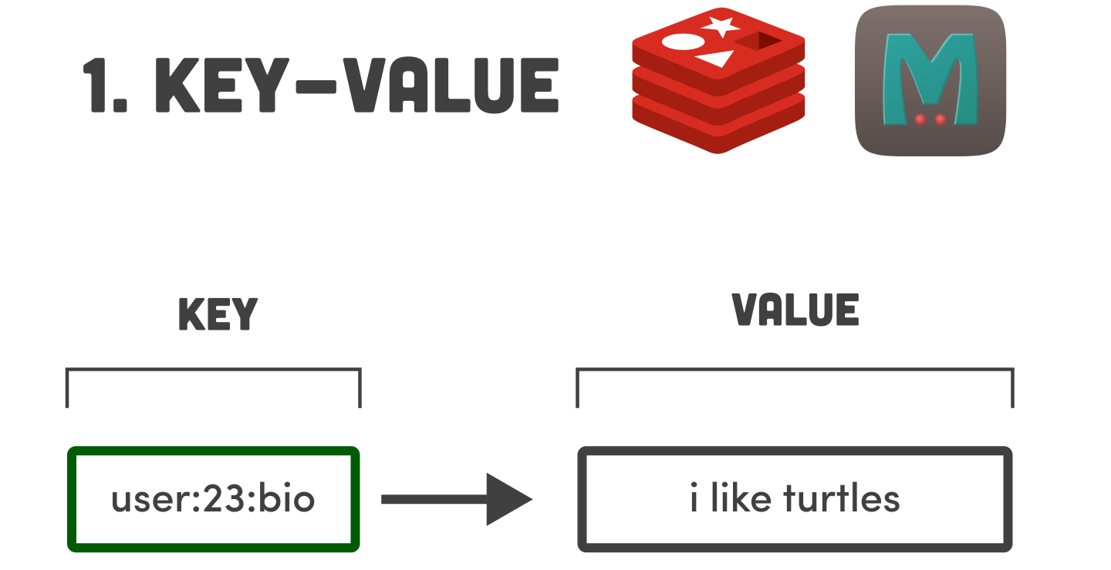
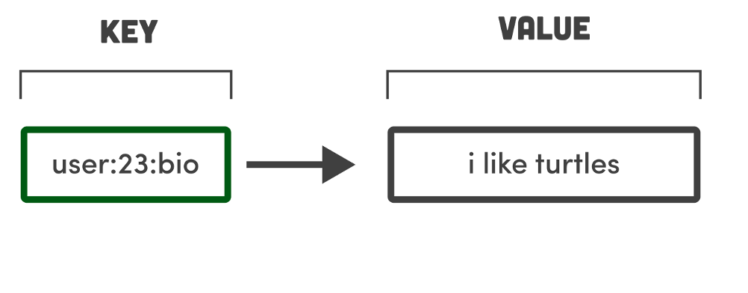
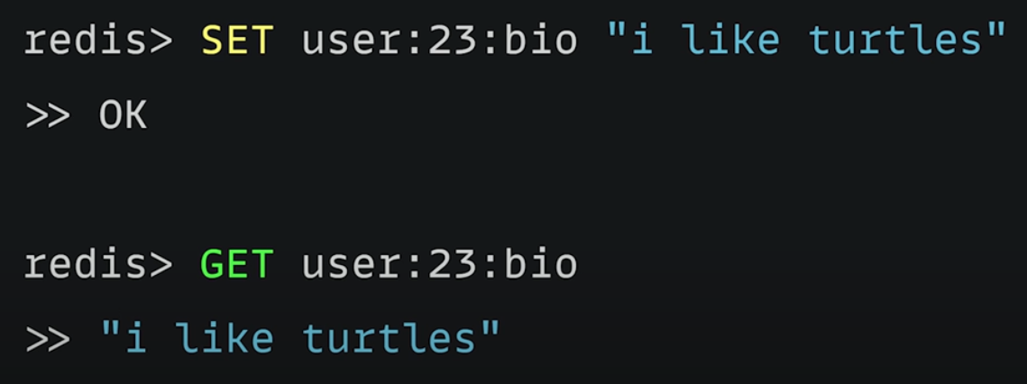
Like a dictionary in Python
In-Memory Database
Limits the amount of data that can be stored
Very fast (sub-microsecond)
No Queries or Joins
Best for
Caching (on top of some persistent storage layer)
Message Queue's
Gaming Leaderboard

Slide 5
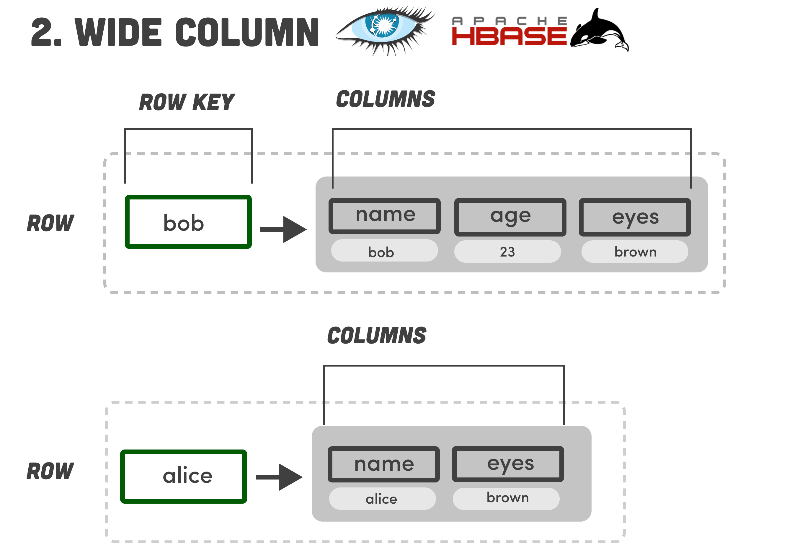
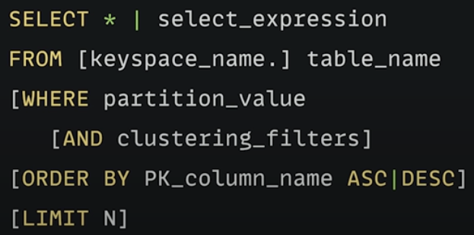
Like a key/value database, but with a second dimension
Structure
Outer layer – Keyspace that contains one or more column families
Each column family contains a set of orders rows
Using partition keys, we can group related data together
Beyond partition key, and cluster (ordering) keys, the number of other columns can vary per row
Unlike Relational Database, it doesn’t have a schema
therefore, you can’t do things like joins
Decentralized
Easy to scale up across multiple nodes
Best for High-Write and Low-Read applications:
Time-Series
Logs/Historical Records
Rarely used as a general app database

Slide 6
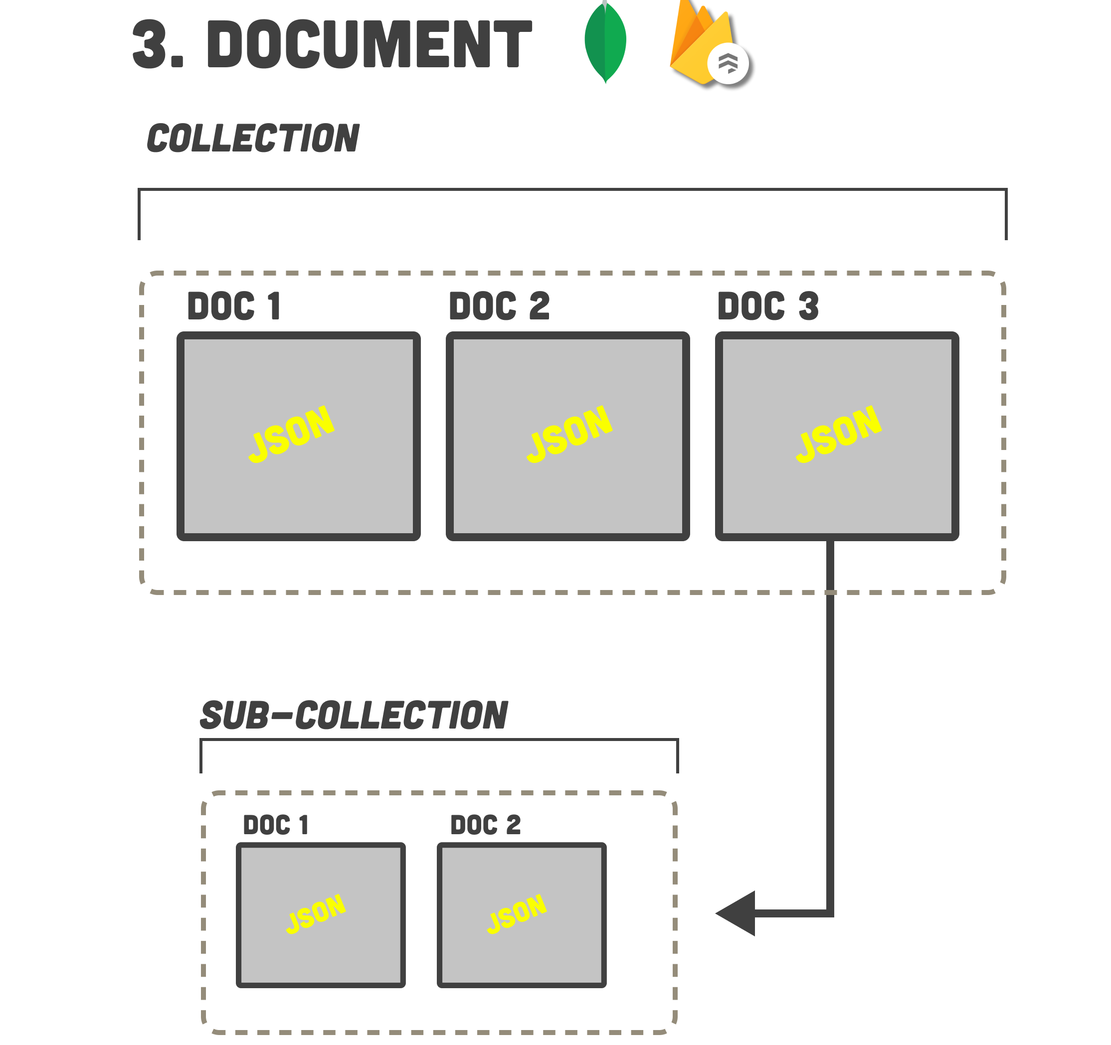
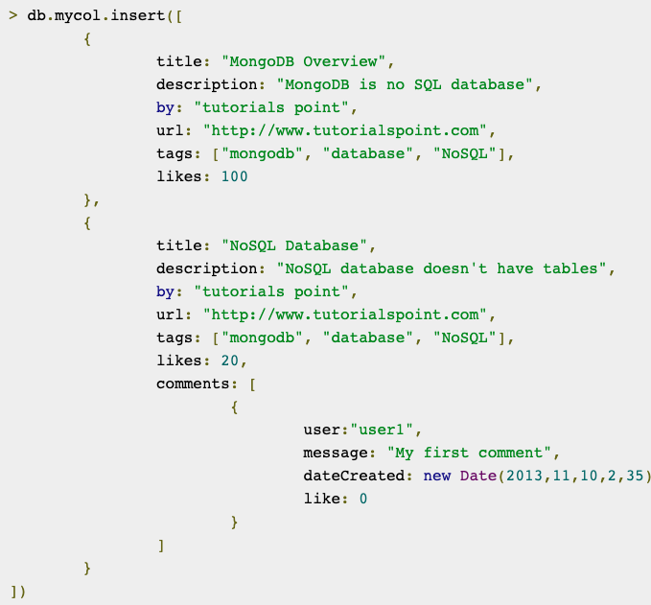
Good for general application database
Database consists of documents
Documents contain key/value pairs in the form of JSON (actually BSON for less space)
Documents are grouped together into collections
Fields in documents can be indexed
Collections can be organized into a logical hierarchy
Characteristics:
Schema-less
Relational like queries
Some (i.e. MongoDB) ACID complient
Best for:
Most phone/web applications
Games
IoT
Content Management

Slide 7
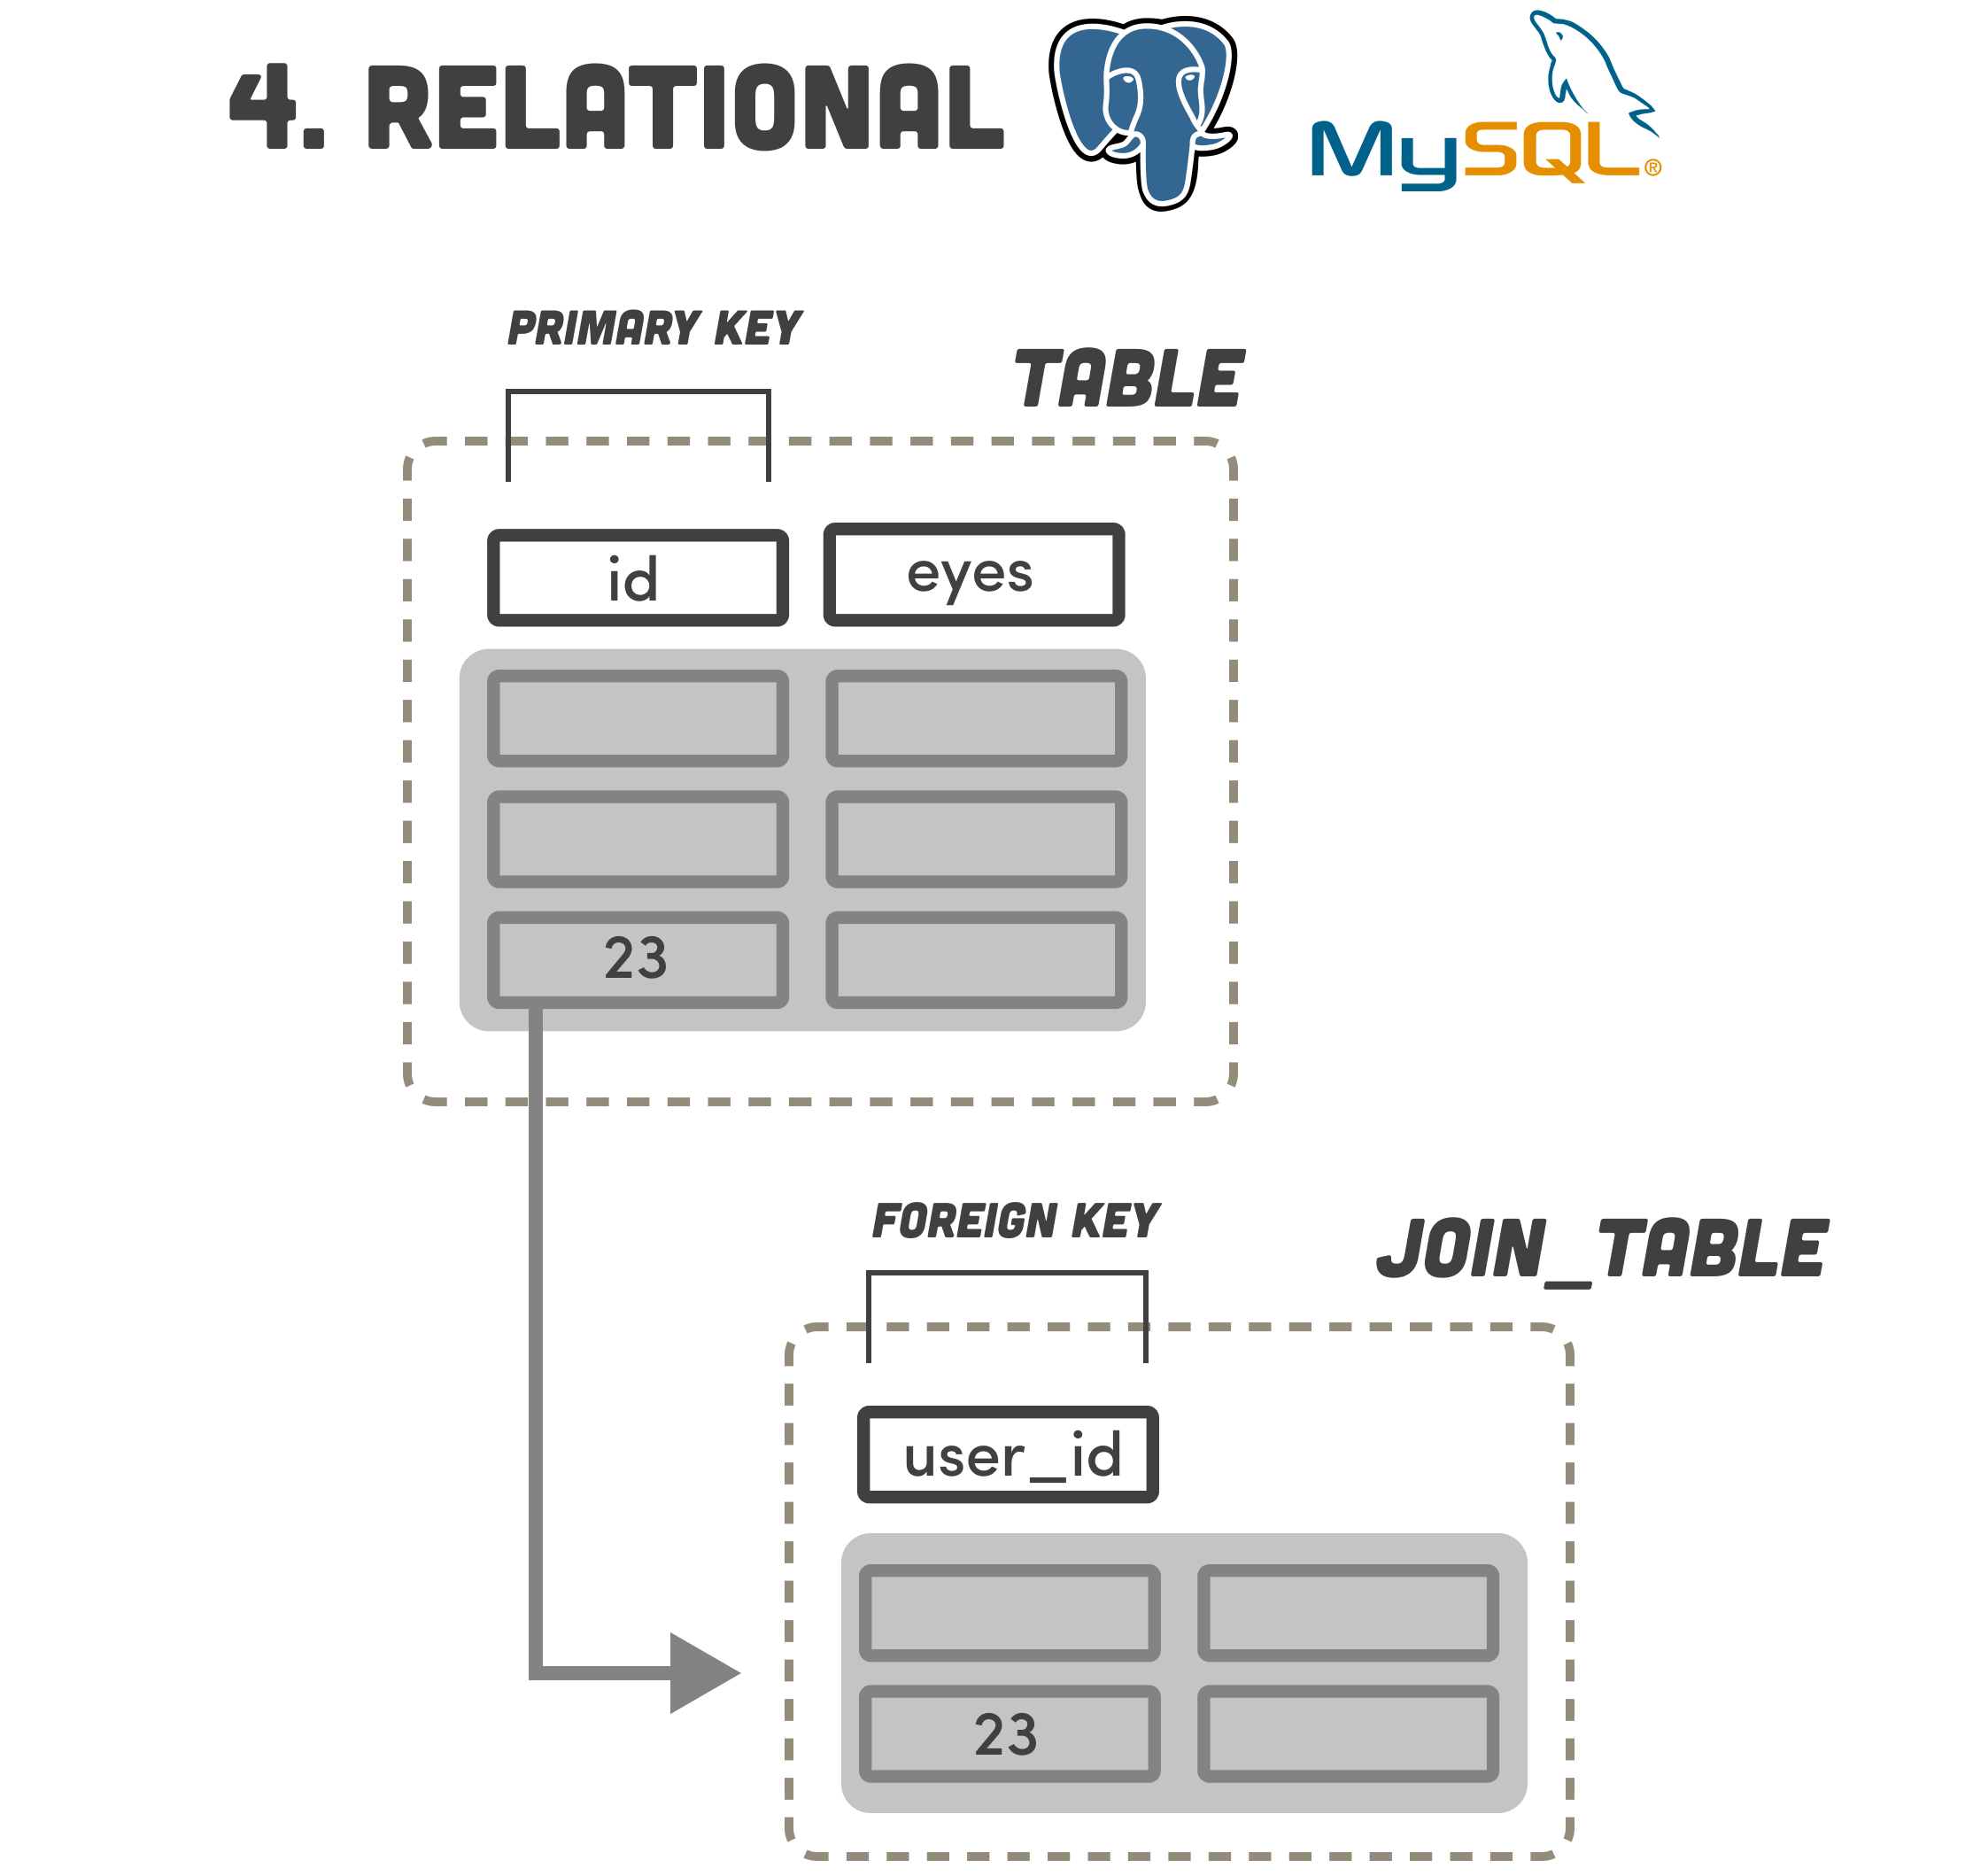
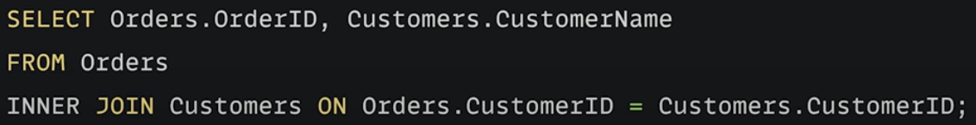
One of the older database forms; and still one of the most popular.
Slow to write
Reasonable fast reads
Doesn’t scale as well as other systems
Strong ACID compliance
Good for analytics (rich query structure and features)
Not ideal for unstructured data

Slide 8
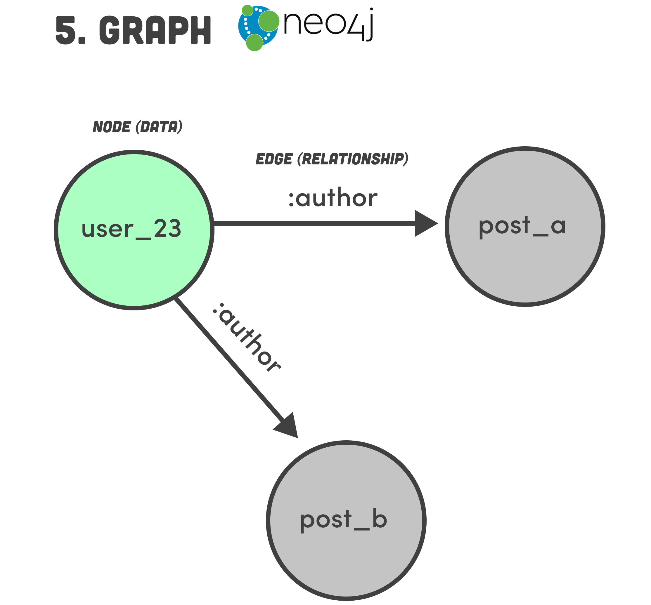
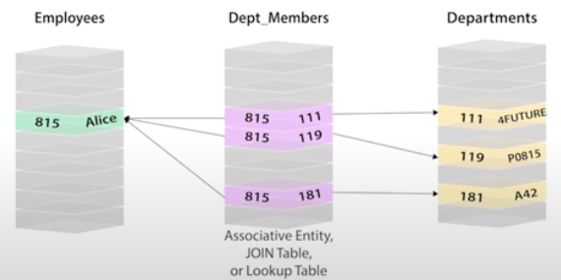
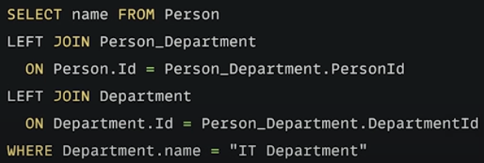
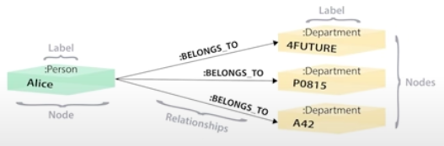
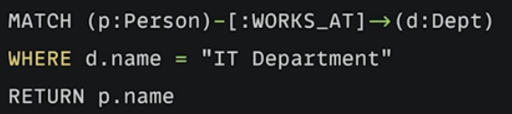
Data is represented as nodes, and relationships between them as edges.
Simpler structure and queries for relational data.
Scales better than RDBMs for very large datasets
Great alternative to SQL/NoSQL – especially when running a lot of joins on very large datasets
Best for:
Graphs
Social Networks
Recommendation Engines
M2M in RDBMs
M2M in Graph DB

Slide 9
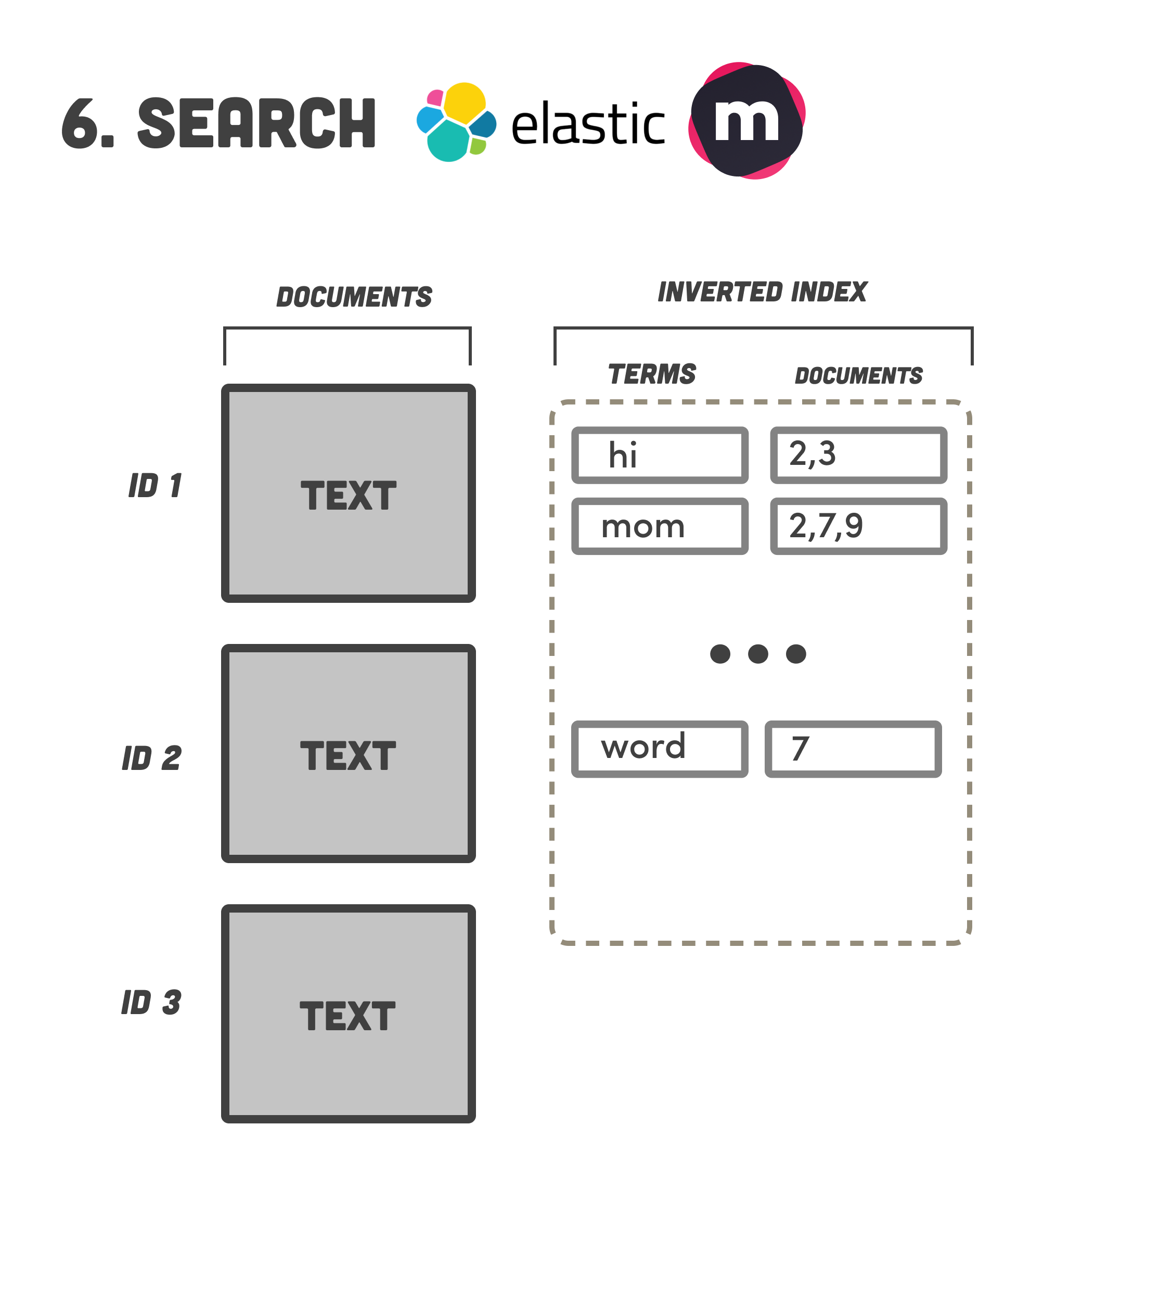
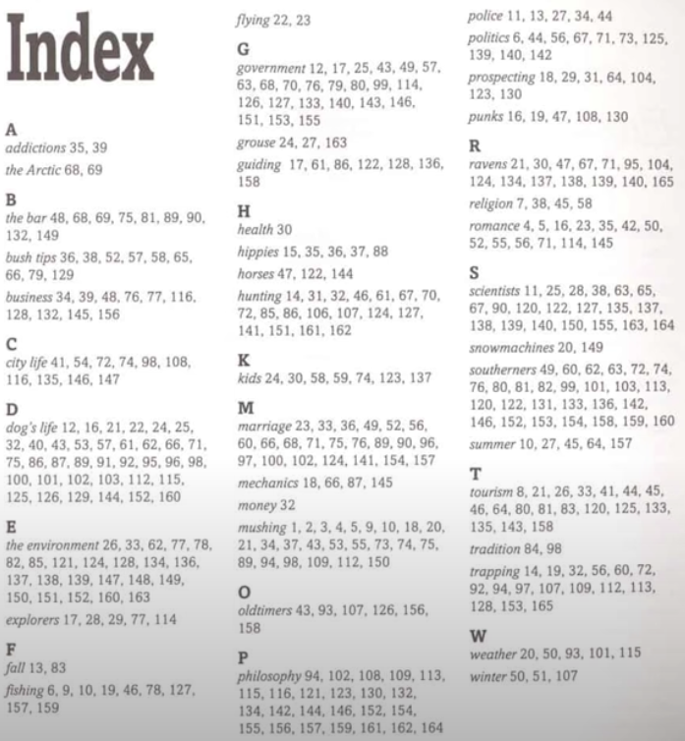
Full text search engine
Analyzes all data in a document and creates an index of searchable terms
Best for:
Search Engines
Typeahead
Think of it like an index at the end of a textbook.

Slide 10
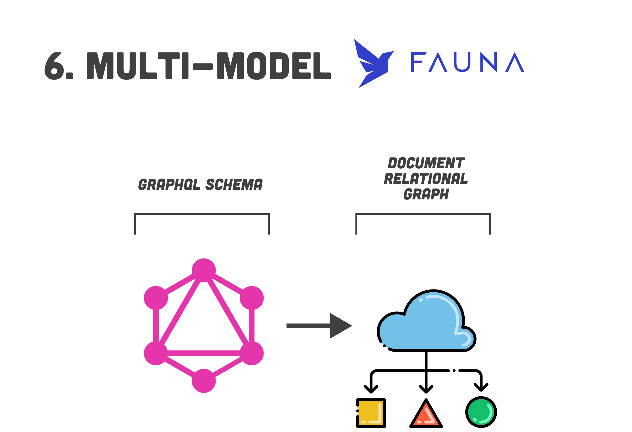
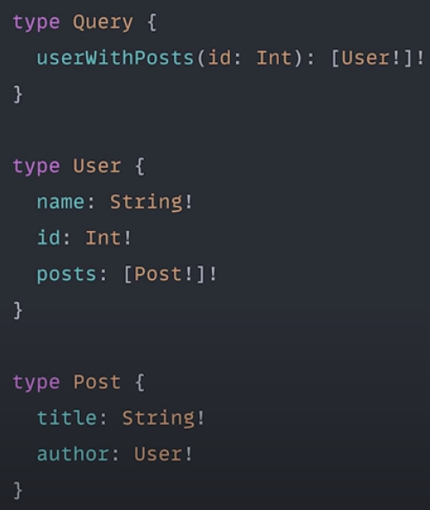
7.
Combinations of the other 6 in one system
Very new
Simple from an application development stand-point.
Hides much of the details (i.e. sharding, partitioning, etc.)
ACID Compliant
Fast

Slide 11






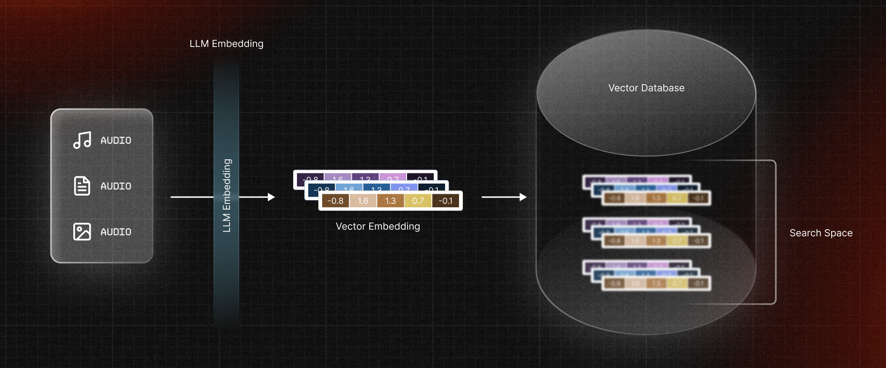
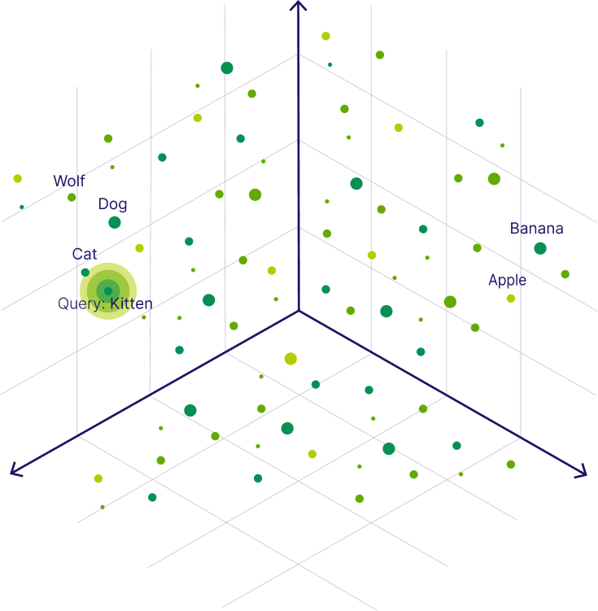
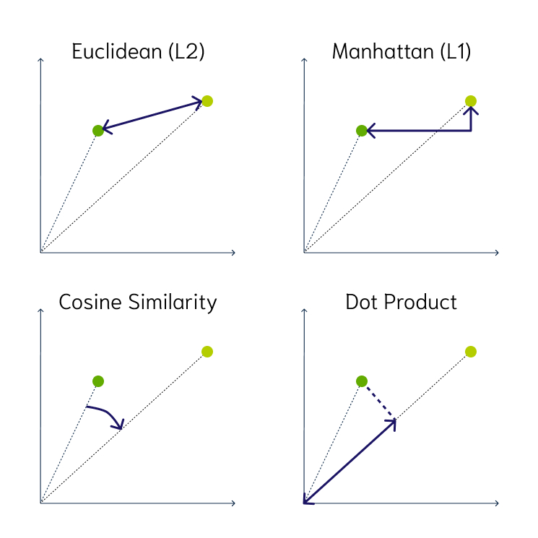
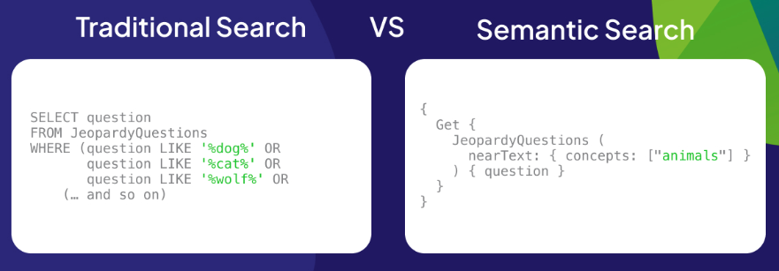
8. Vector
Finds and retrieves similar objects
Very new
Used extensively in modern AI LLM Apps

Slide 12
MongoDB
Dr. Tim Smith

Slide 13
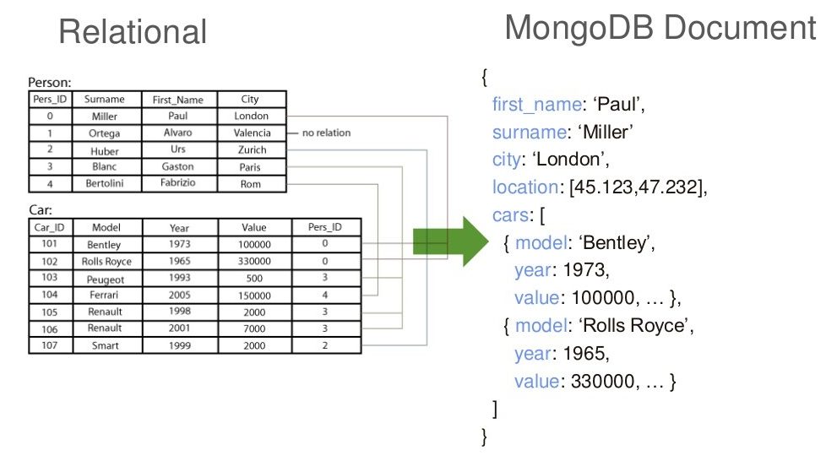

What is MongoDB?
MongoDB is an open source, document-oriented database designed with both scalability and developer agility in mind.
Instead of storing your data in tables and rows as you would with a relational database, in MongoDB you store JSON-like documents with dynamic schemas(schema-free, schema less).
JavaScript query Syntax

Slide 14
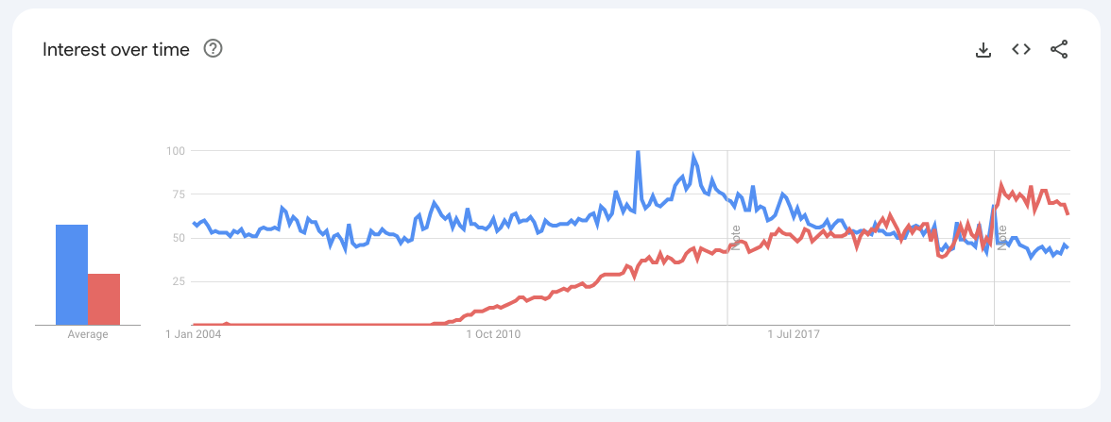
Cassandra vs MongDB Search Popularity
https://trends.google.com/trends/explore?date=all&q=cassandra,MongoDB&hl=en-GB

Slide 15
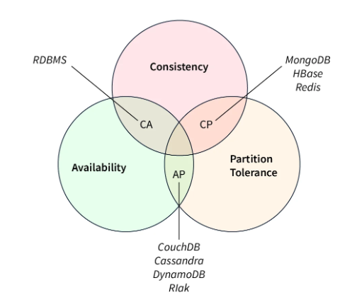
CAP Theorem
The CAP Theorem (also known as Brewer’s Theorem) is a principle in distributed system theory that states that it is impossible for a distributed system to simultaneously guarantee three properties: consistency "C", availability "A", and partition tolerance "P".
MongoDB is positioned in the CP area, while Cassandra is in the AP area. Traditional RDBMs are in the CA area.

Slide 16
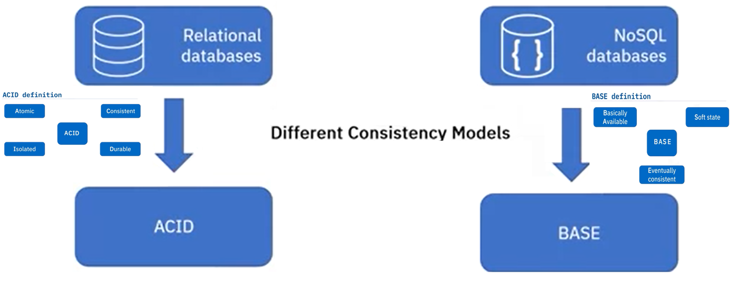
ACID vs BASE
MongoDB is a NoSQL database that is also ACID compliant!
Atomicity - each statement in a transaction (to read, write, update or delete data) is treated as a single unit. Either the entire statement is executed, or none of it is executed. This property prevents data loss and corruption from occurring if, for example, if your streaming data source fails mid-stream.
Consistency - ensures that transactions only make changes to tables in predefined, predictable ways. Transactional consistency ensures that corruption or errors in your data do not create unintended consequences for the integrity of your table.
Isolation - when multiple users are reading and writing from the same table all at once, isolation of their transactions ensures that the concurrent transactions don't interfere with or affect one another. Each request can occur as though they were occurring one by one, even though they're actually occurring simultaneously.
Durability - ensures that changes to your data made by successfully executed transactions will be saved, even in the event of system failure.
Basically Available – the database ensures that all data is available by ensuring that it’s stored across multiple nodes. This means that even if some nodes are unavailable, it’s much more likely that all of the data can still be accessed, but at the cost that it takes a non-zero amount of time for the data to spread across the nodes
Soft-state – because the same data is stored across multiple nodes, and because this data may take time to get to every node, this means that the database can’t strongly enforce data integrity. Instead, it’s assumed that the client application will be doing this
Eventually consistent – because the data is stored across multiple nodes, there is no guarantee that reading from one node will immediately reflect writes to another node. These reads will be consistent in time but not immediately

Slide 17
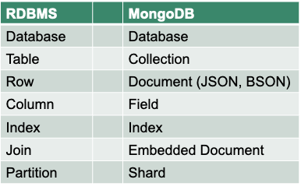
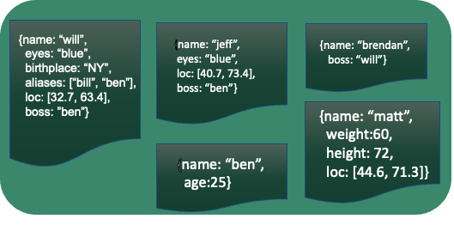
Schema-Less
MongoDB does not need any pre-defined data schema
Every document could have different data!

Slide 18
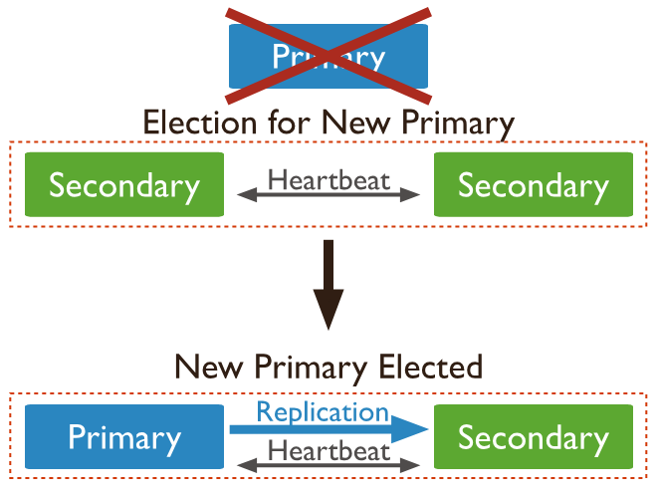
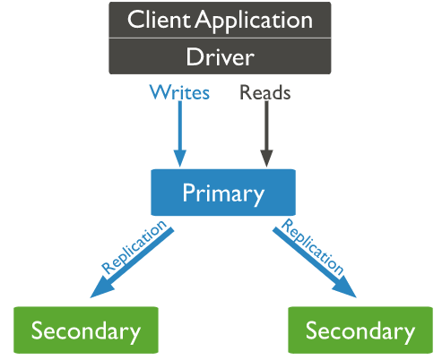
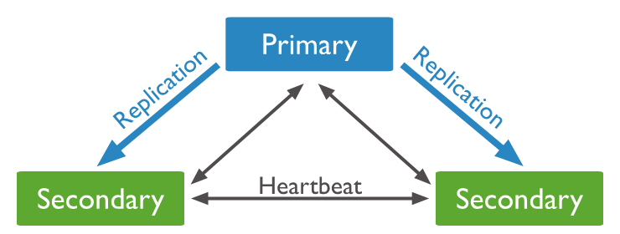
Replication
MongDB increases availability through replication.
Replication minimizes downtime by keeping active copies of the database.
A failure of a primary results in the secondaries ‘electing’ a new primary.
It is recommended for productive deployment to always use MongoDB as a replica-set of at least three servers

Slide 19
Replica-set
A Replica-Set means that you have multiple instances of MongoDB, with each mirroring all the data of each other. A replica-set consists of one "Primary" and one or more "Secondaries".
A Replica-Set
All write-operations go to the primary and are then replicated to the secondaries. So, writes won’t get faster when you add more secondaries.
Read-operations, on the other hand, can be served by any secondary. When you have a lot of read requests, you can increase read performance by adding more secondaries to the replica-set and having your clients distribute their requests to different members of the replica-set.
Copy of database

Slide 20
Sharding
A Sharded Cluster means that each shard of the cluster (which can also be a replica-set) takes care of a part of the data. Each request, both reads and writes, is served by the cluster where the data resides. This means that both read- and write performance can be increased by adding more shards to a cluster.
Sharded Cluster
Shard A
Shard B
Shard C
Which document resides on which shard is determined by the shard key of each collection. It should be chosen in a way that the data can be evenly distributed on all clusters and so that it is clear for the most common queries where the shard-key resides

Slide 21
MongoDB Features
Document-Oriented storage
Full Index Support
Replication & High Availability
Auto-Sharding
Aggregation
Language Support
JavaScript, Python, Ruby, Perl, Java, Java, Scala, C#, C++, Haskell, Erlang
Active Community
Good documentation
ACID Compliant!

Slide 22
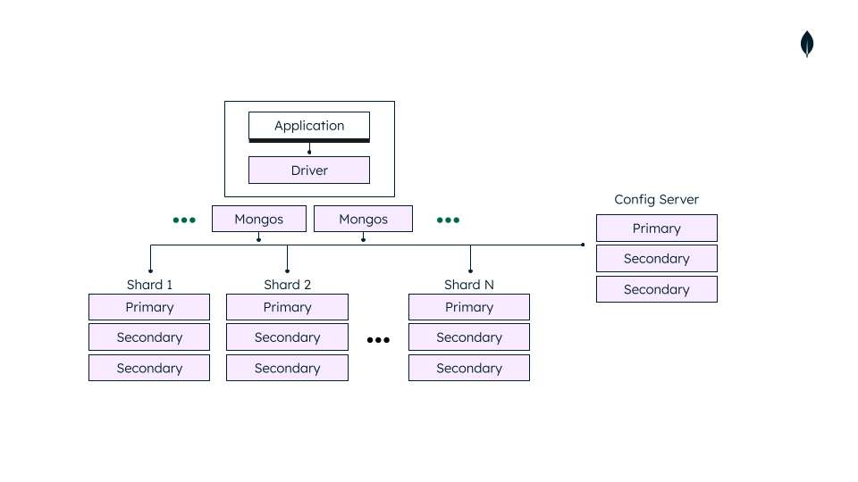
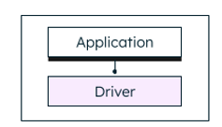

An example Sharded Cluster architecture in production…
Proxy Server(s)
Config servers store the metadata for a sharded cluster. The metadata reflects state and organization for all data and components within the sharded cluster. The metadata includes the list of chunks on every shard and the ranges that define the chunks.

Slide 23
Follow along with supplied notebooks
Got to our classroom GitHub Repo
https://github.com/prof-tcsmith/dm-f23

Slide 24
This week
Work through the supplied MongoDB tutorial on Canvas (it’s very short)
Work through all of the MongoDB Tutorial Notebooks
Take MongoDB Quiz
Complete MongoDB assignment

Slide 25
This week
MongoDB Tutorial Notebooks
Create your MongoDB Atlas Account
Insert data
Query Data
Update Data
Advanced Queries
Aggregation (MongoDB version of MapReduce)
Reading BSON data
Writing BASON data

Slide 26
MidTerm Next week
Multiple Choice
Closed book
You can bring one page 8 by 11 sheet with notes
20-30 minutes in length
20-30 multiple choice questions
Covers all the topics covered thus far
Programming Problem
A programming problem/task that will require you to demonstrate knowledge of the topics covered thus far.
Closed book
You will use DEV01 environment
You can access any of your work stored on DEV01
No other sources or assistance allowed
Up to 120 minutes in length

Slide 27
Happy Learning!

